Slide 1

In the name of God
Analysis of deep learning-based intrusion detection systems in Internet of Things networks
Security in IoT Course
Dr. Siavash Ahmadi
Sharif University of Technology – Department Electrical Engineering
Mohammad Ali Sharifi Mehr
Pouria DadKhah

Slide 2
Table of Contents
1
Introduction
2
Basic definitions and concepts
3
An overview of intrusion detection systems
4
Systems analysis and evaluation results
5
Conclusion

Slide 3
Table of Contents
1
Introduction
2
Basic definitions and concepts
3
An overview of intrusion detection systems
4
Systems analysis and evaluation results
5
Conclusion

Slide 4
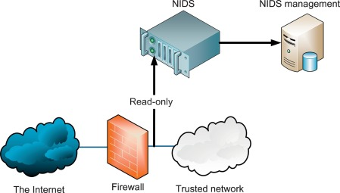
Introduction
Application
Network/System Security
Tools
firewall
Ids/Ips
Honeypot
Performance improvement?!
Make more use of existing features
Resilience against hostile attack

Slide 5
Table of Contents
1
Introduction
2
Basic definitions and concepts
3
An overview of intrusion detection systems
4
Systems analysis and evaluation results
5
Conclusion

Slide 6
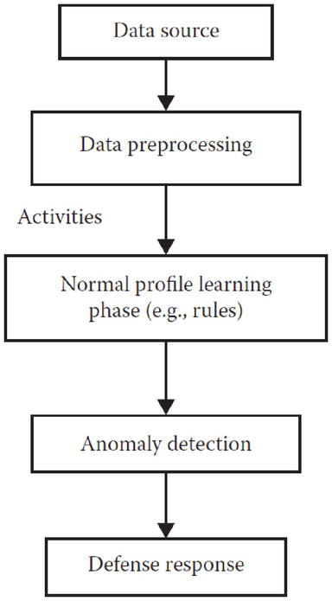

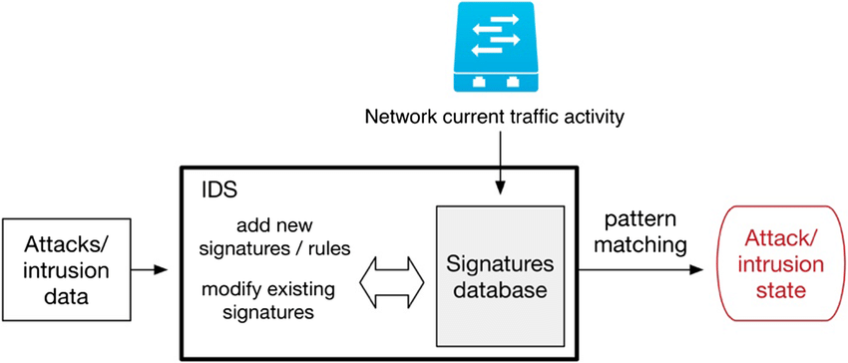
Types of intrusion detection
Anomaly
Data dependency
Interpretation of the result
Misuse
Efficiency
performance
New attacks
[6]

Slide 7
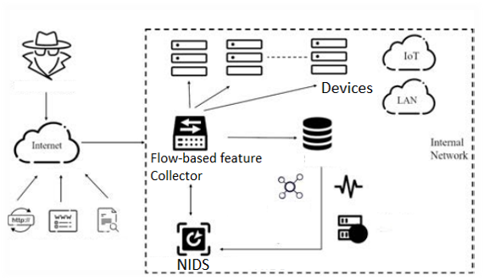
Threat model!
Guanghan Duan et al [1]

Slide 8
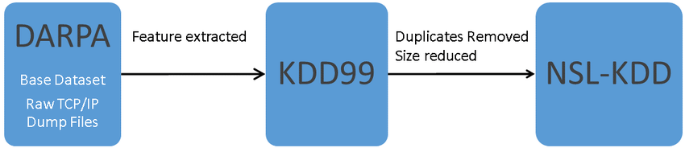
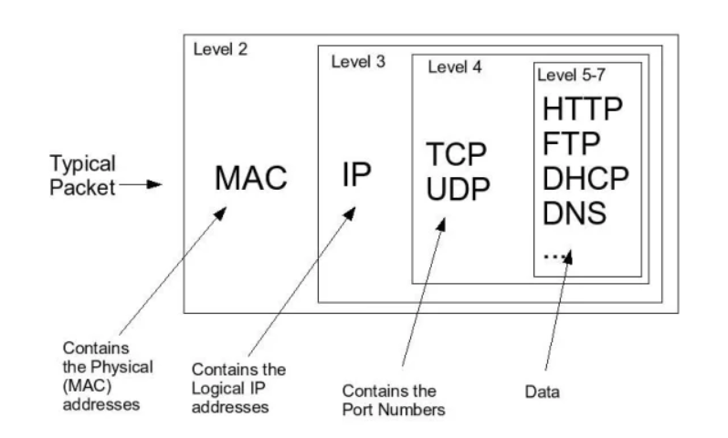
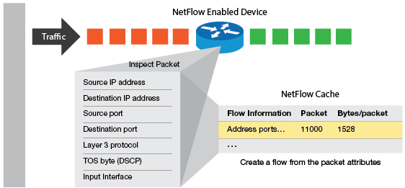

Training data
Public Datasets
Packet Level Data
NetFlow Data

Slide 9
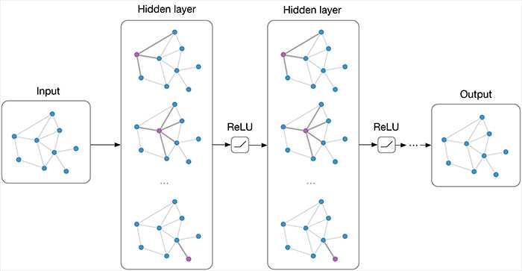

Neural Network Graph
Irregular data structure
Modeling the connectivity of nodes
$$H^{\left[i+1\right]}= σ\left(W^{\left[i\right]}H^{\left[i\right]}+b^{\left[i\right]}\right)$$
Peter Viktovich at [5]
Graph
Message transfer
Aggregation of features
Node state update

Slide 10
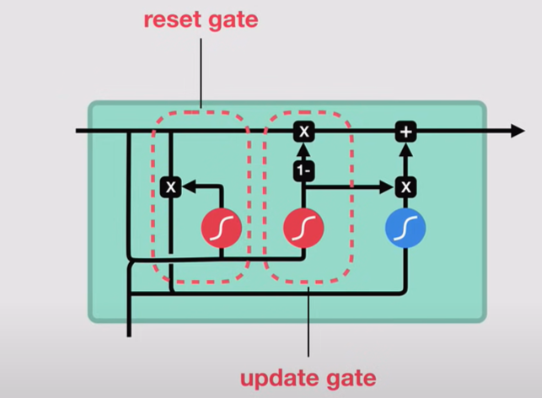
Gateway return unit
Improving the RNN fading/explosion problem
Separation into influential and unimportant terms
Example of predicting the output of a sentence!
Agarap et al [4]

Slide 11
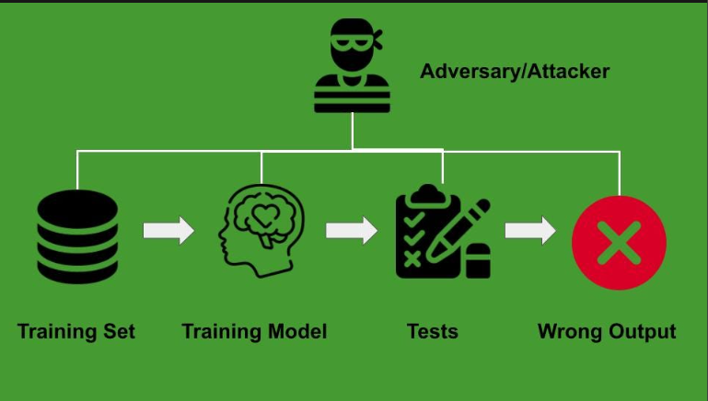
Hostile attacks
Poisoning
Evasion
Extraction
Inversion

Slide 12
Table of Contents
1
Introduction
2
Basic definitions and concepts
3
An overview of intrusion detection systems
4
Systems analysis and evaluation results
5
Conclusion

Slide 13
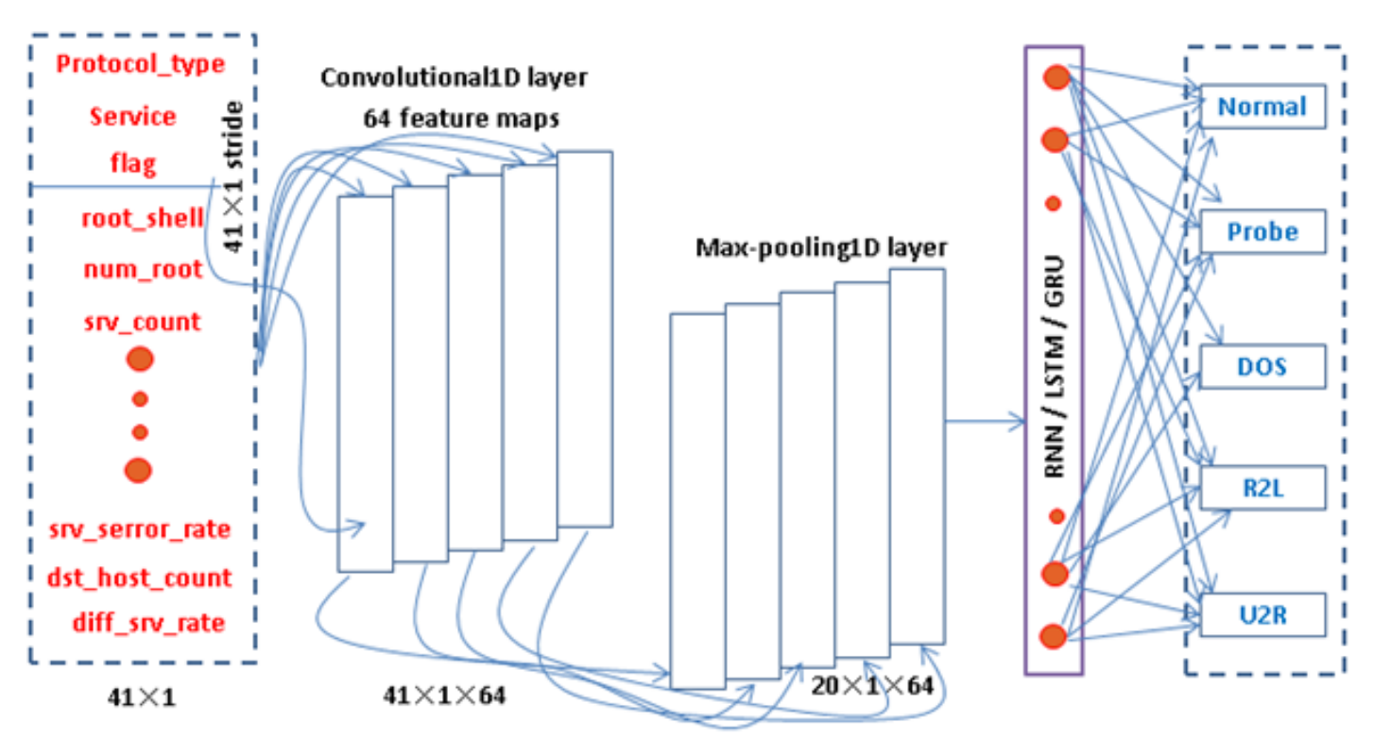
Non-graph Networks
Combined methods
Peter Viktovich at [5]
Torsion networks
Recurrent networks
Statistical properties of packets
Checking the flow of time

Slide 14
Graph based Networks
Network Structure
Security Object Graph
Spatio-temporal characteristics
Embedding the graph structure
history and potential of the graph!
Network shape extraction
Interaction between pairs of points
Statistical properties of packets

Slide 15
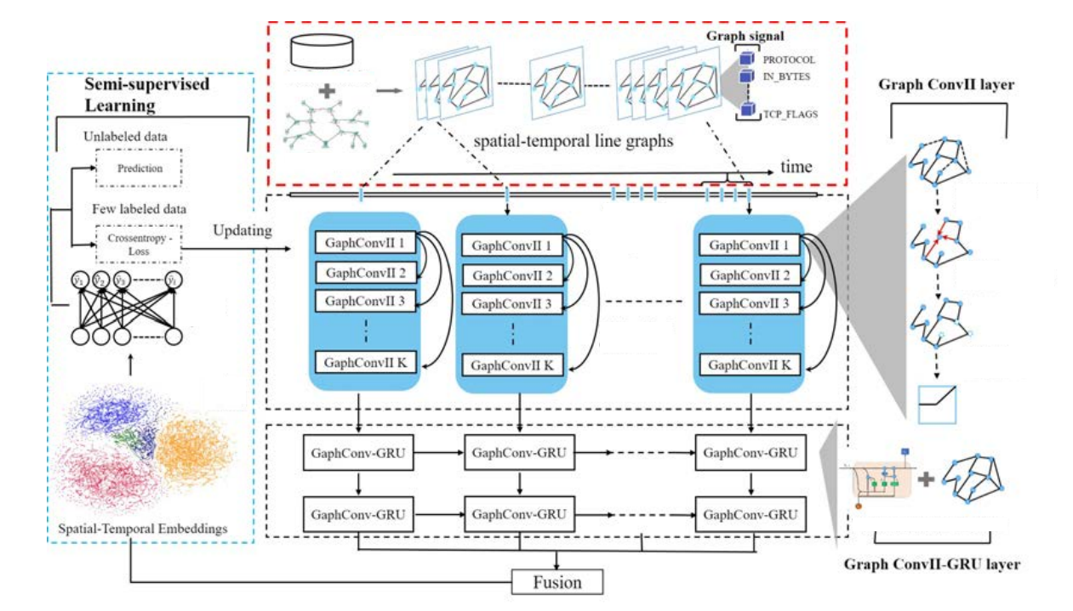
Guanghan Duan et al [1]

Slide 16
Table of Contents
1
Introduction
2
Basic definitions and concepts
3
An overview of intrusion detection systems
4
Systems analysis and evaluation results
5
Conclusion

Slide 17
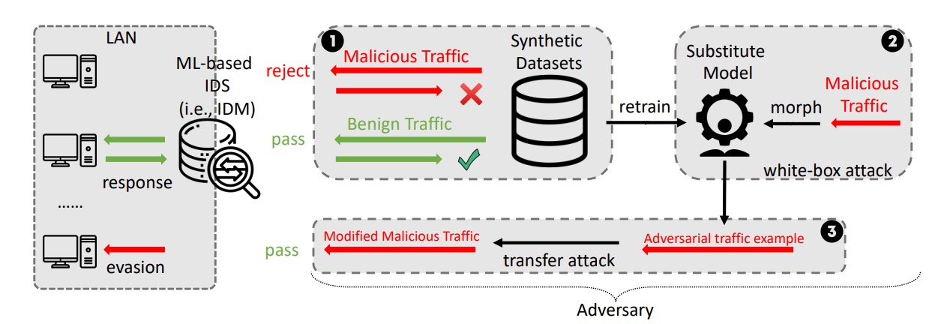
Deception attack

Slide 18

Type of Attack
Feature Level
Generative Feature Level
Packet Level

Slide 19
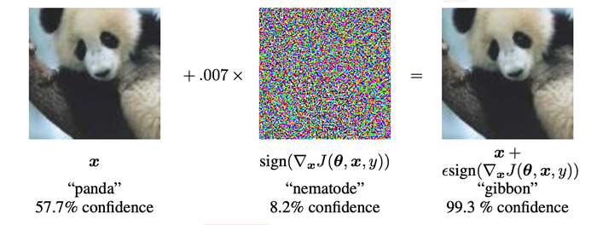
Adversarial data generation
FGSM
BIM
DeepFool
JSMA

Slide 20
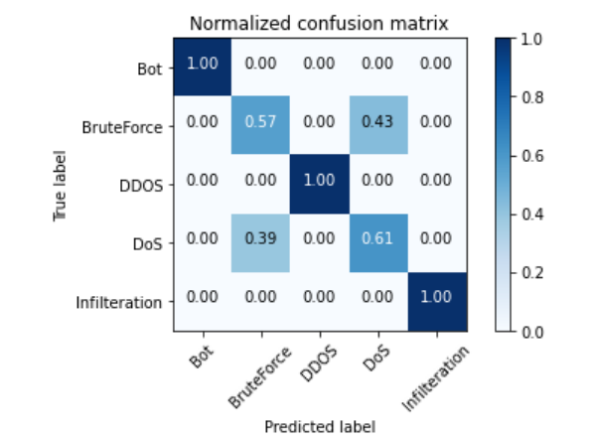
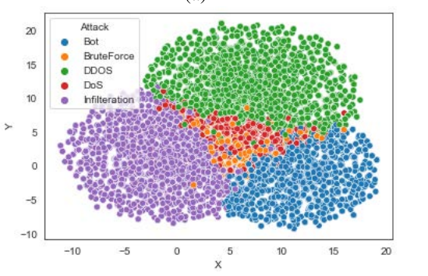
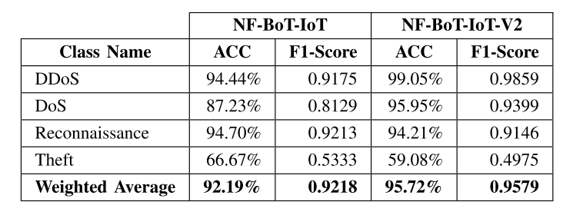
Method evaluation; comparison of different attacks
Guanghan Duan et al [1]

Slide 21
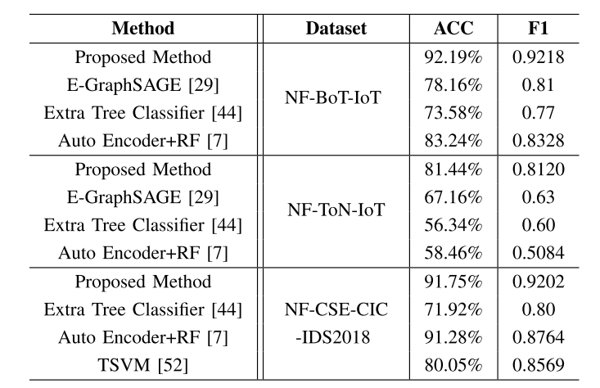
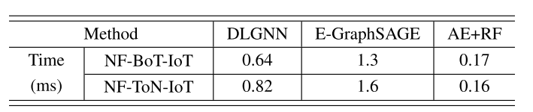
Method evaluation; multiple classification
Guanghan Duan et al [1]

Slide 22
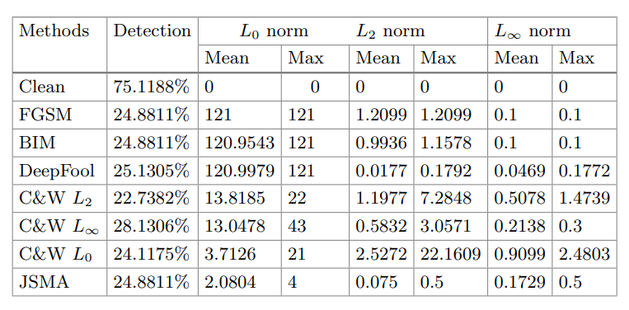
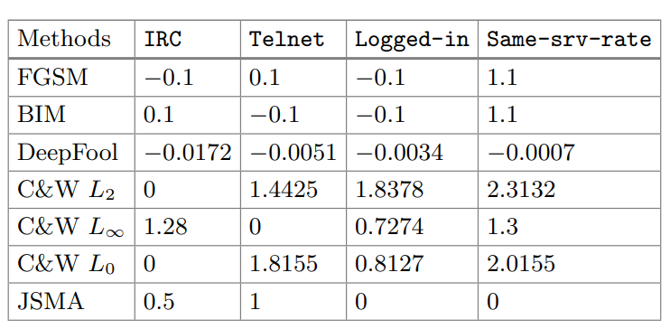
White box attack assessment

Slide 23
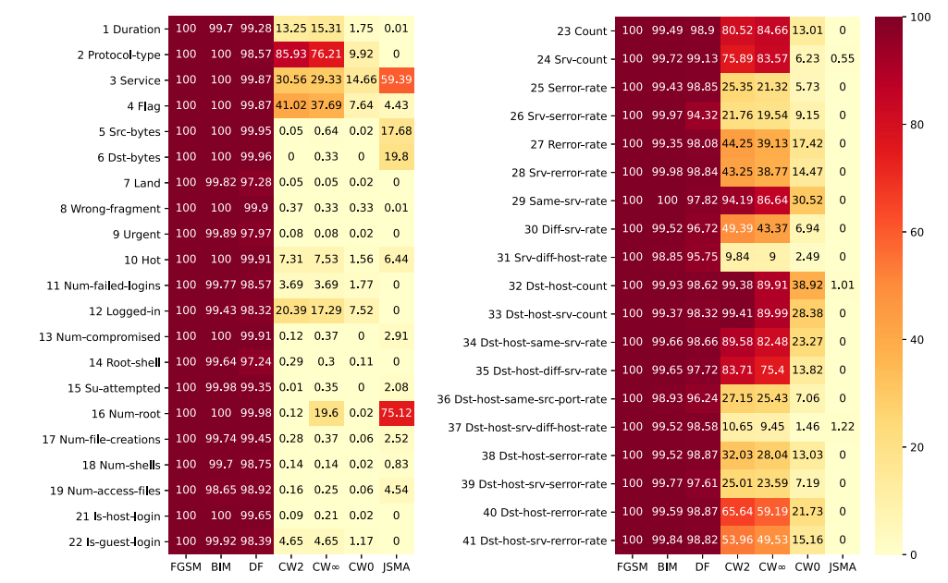
White box attack assessment

Slide 24
Table of Contents
1
Introduction
2
Basic definitions and concepts
3
An overview of intrusion detection systems
4
Systems analysis and evaluation results
5
Conclusion

Slide 25
Conclusion and future work
Security requirement definition
Review of applied methods
Improving performance with graph tools
Adversarial data attack
Existing challenges
Resisting adversarial attacks!
Simulating real network and unequal devices
Network-dependent attack

Slide 26
Important resources
[1] Application of a Dynamic Line Graph Neural Network for Intrusion Detection With Semisupervised Learning. Guanghan Duan. IEEE TRANSACTIONS ON INFORMATION FORENSICS AND SECURITY, VOL. 18, 2023
[2] Applying convolutional neural network for network intrusion detection . R. Vinayakumar, K. P. Soman, and P. Poornachandran, in Proc. Int. Conf. Adv. Comput., Commun. Informat. (ICACCI), Sep. 2017, pp. 1222–1228
[3] F. Manessi, A. Rozza, and M. Manzo, “Dynamic graph convolutional networks,” Pattern Recognit., vol. 97, Jan. 2020, Art. no. 107000
[4] A. F. M. Agarap, “A neural network architecture combining gated recurrent unit (GRU) and support vector machine (SVM) for intrusion detection in network traffic data,” in Proc. 10th Int. Conf. Mach. Learn. Comput., Feb. 2018, pp. 26–30
[5] https://neptune.ai/blog/graph-neural-network-and-some-of-gnn-applications
[6] A Comparative Study of Various Clustering Approach for Intrusion Detection based on Mining Techniques

Slide 27
Thanks for your attention

